Slide 1


Bike sharing demand prediction
Name : j.Niharika
Reg.no : 221fa14019
Bioinformatics -3A

Slide 2
Bike Sharing Demand Problem Statement: Currently Rental bikes are introduced in many urban cities for the enhancement of mobility comfort. It is important to make the rental bike available and accessible to the public at the right time as it lessens the waiting time. Eventually, providing the city with a stable supply of rental bikes becomes a major concern. The crucial part is the prediction of bike count required at each hour for the stable supply of rental bikes.

Slide 3
content
❑ Data Pipeline
❑ Data Description
❑ Exploratory Data Analysis
❑ Models performed
❑ Model Validation & Selection
❑ Evaluation Matrix of All the models
❑ Model Explainability - SHAP
❑ Challenges
❑ Conclusion

Slide 4
Data pipeline
Exploratory Data Analysis (EDA): In this part we have done some EDA on the features to see the trend.
● Data Processing: In this part we went through each attributes and encoded the categorical features.
● Model Creation: Finally in this part we created the various models. These various models are being analysed and we tried to study various models so as to get the best performing model for our project.

Slide 5
Data description
Dependent variable:
• Rented Bike count - Count of bikes rented at each hour
Independent variables:
• Date : year-month-day
• Hour - Hour of he day
• Temperature-Temperature in Celsius
• Humidity - %
• Windspeed - m/s
• Visibility - 10 m
• Dew point temperature - Celsius

Slide 6
Solar radiation - MJ/m2
• Rainfall - mm
• Snowfall - cm
• Seasons - Winter, Spring, Summer, Autumn
• Holiday - Holiday/No holiday
• Functional Day - NoFunc(Non Functional Hours), Fun(Functional hours)

Slide 7
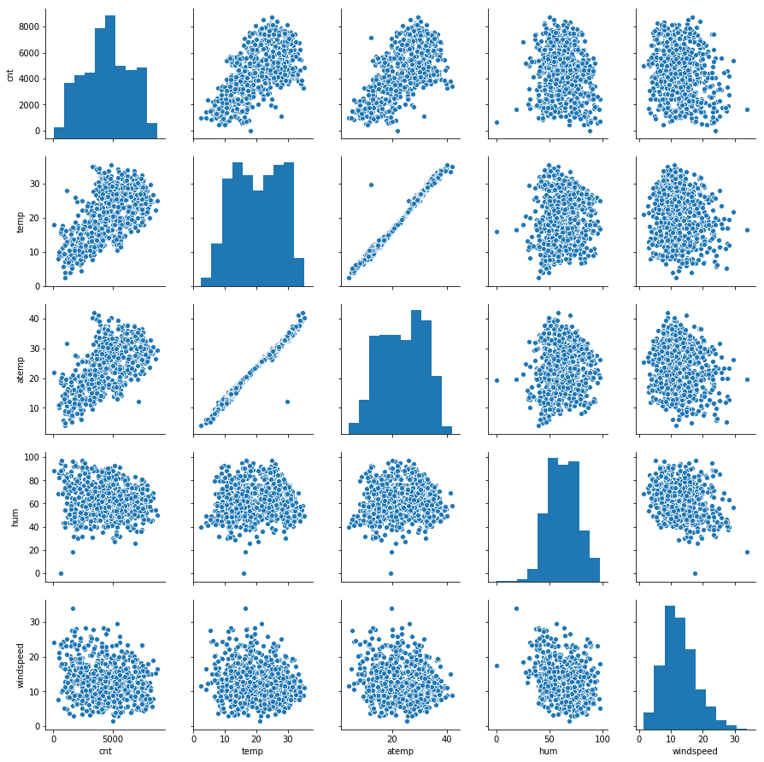
Visualizing the data

Slide 8
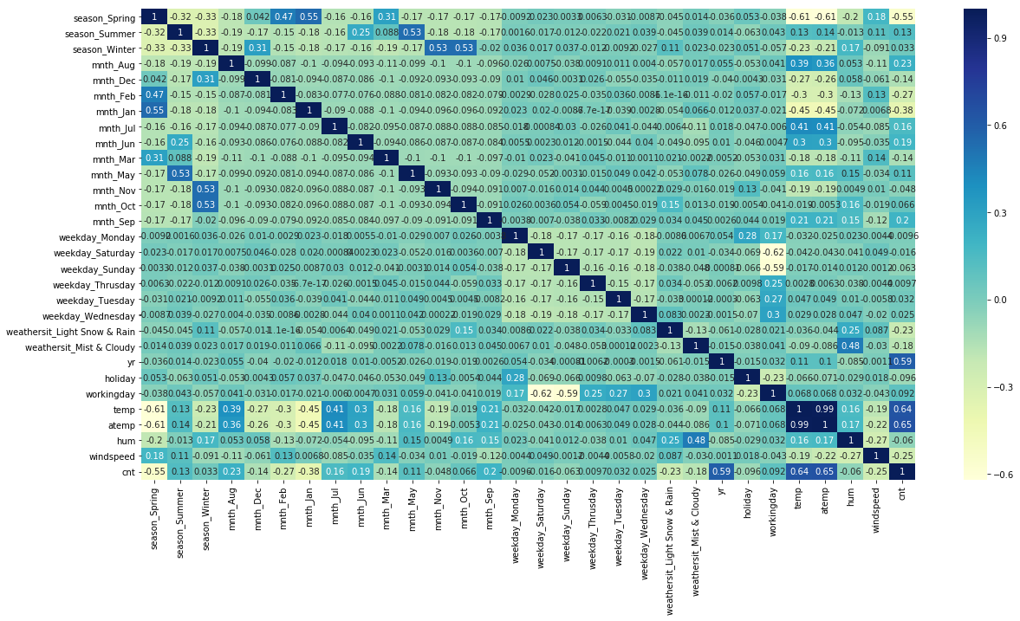
EDA feature correlation

Slide 9
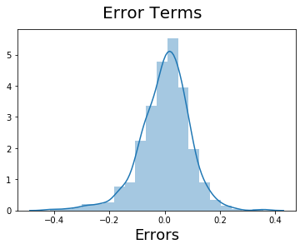
EDA(contd)

Slide 10
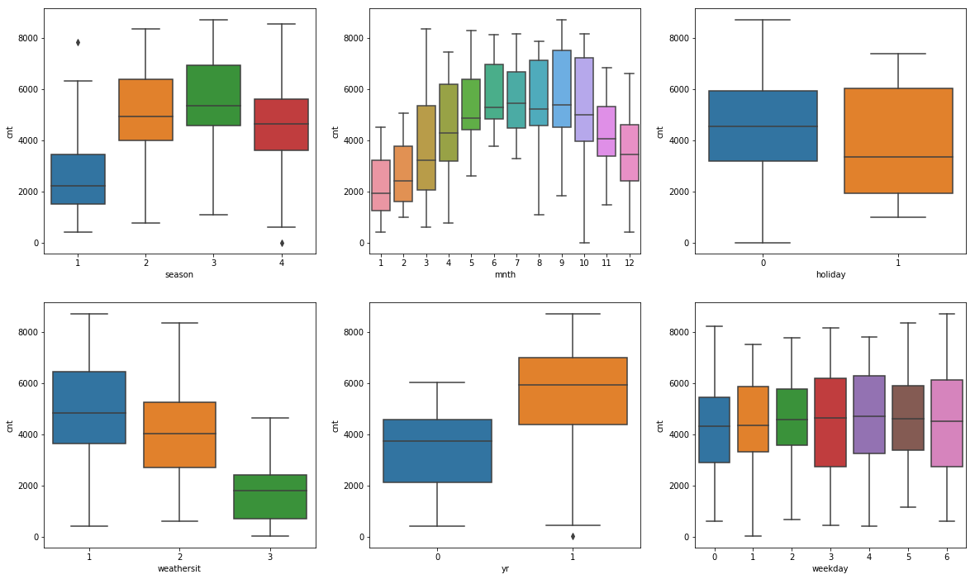
EDA(contd..)
Less demand on winter seasons
• Slightly Higher demand during Non holidays
• Almost no demand on non functioning day

Slide 11
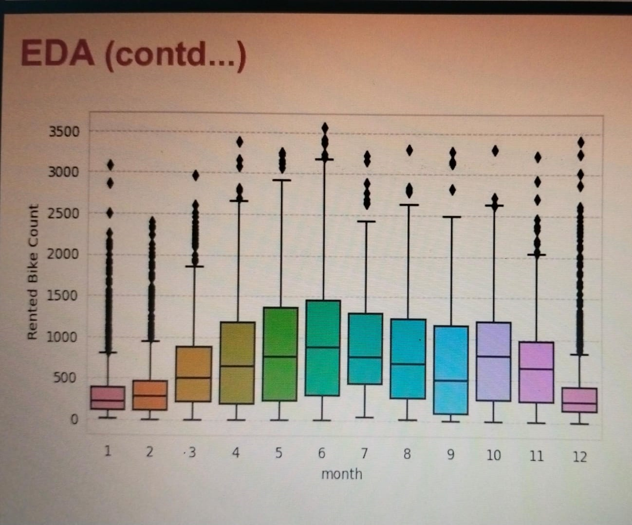
We can see that there less demand of Rented bike in the month of December, January, February i.e. during winter seasons
• Also demand of bike is maximum during May, June, July i.e Summer seasons.

Slide 12
Models performed
Linear Regression with regularizations
Polynomial Regression
K nearest neighbours
Decision tree
Random forest
Gradient Boost
eXtreme Gradient Boost
lightGBM
CatBoost

Slide 13
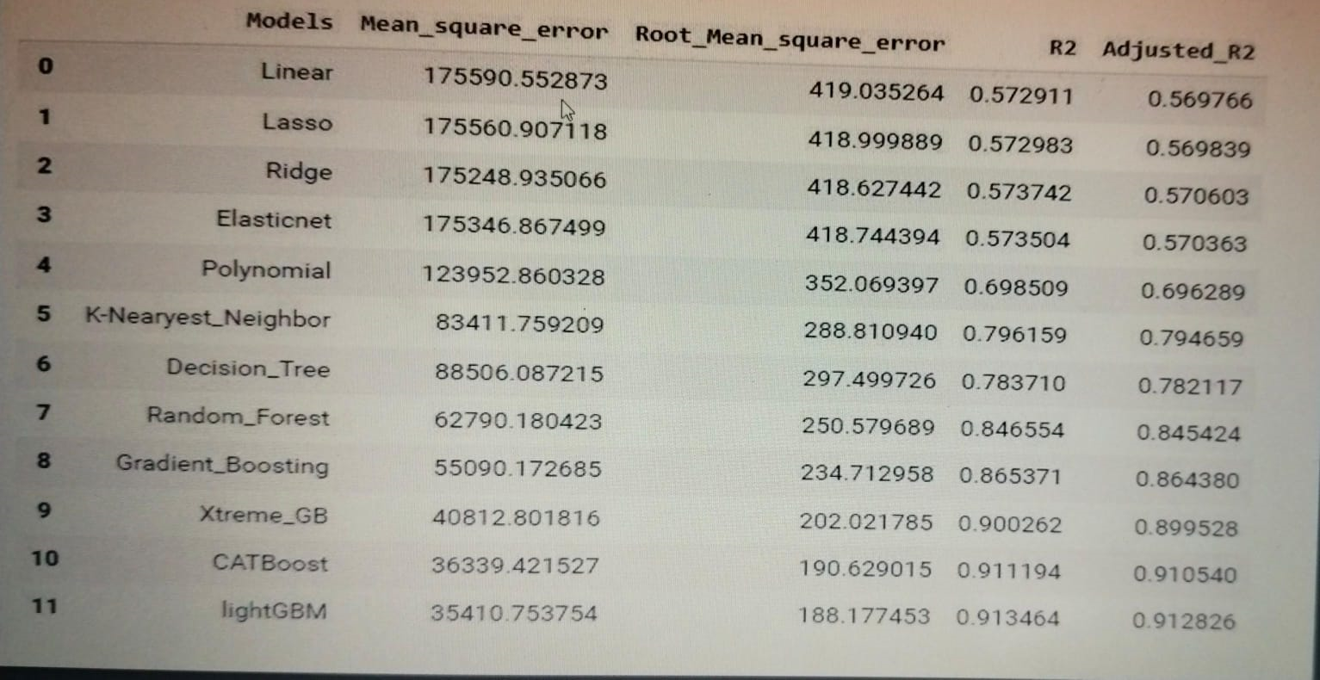
Models evaluation matrices

Slide 14
Model validation & selection
Observation 1: As seen in the Model Evaluation Matrices table, Linear Regression, KNN is not giving great results.
Observation 2: Random forest & GBR have performed equally good in terms of adjusted r2.
Observation 3: We are getting the best results from lightGBM and CatBoost.

Slide 15
Challenges
A huge amount of data needed to be dealt while doing the project which is quite an important task and also even small inferences need to be kept in mind.
As dataset was quite big enough which led more computation time

Slide 16
Conclusion
It is quite evident from the results that lightGBM and Catboost is the best model that can be used for the Bike Sharing Demand Prediction since the performance metrics (mse,rmse) shows lower and (r2,adjusted_r2) show a higher value for the lightGBM and Catboost models.
So, we can use either lightGBM or catboost model for the above problem

Slide 17
Thank you

